Slide 1

Name: SREEJA SETH
Skill Build emailid: it2020005@rcciit.org.in
Organization: DGT
College Name: RCC Institute Of Information Technology
College Address: Kolkata, West Bengal
Internship Domain: Cyber Security
Internship Start Date:09/06/2023
Internship End Date:24/07/2023

Slide 2

PROJECT TITLE/Problem Statement
Keylogger Capturing Key strokes:
Keyloggers, or keystroke loggers, are tools that record what a person types on a device. While there are legitimate and legal uses for keyloggers, many uses for keyloggers are malicious.

Slide 3
AGENDA
Cybersecurity is the practice of protecting systems, networks, and programs from digital attacks. These cyberattacks are usually aimed at accessing, changing, or destroying sensitive information; extorting money from users via ransomware; or interrupting normal business processes.
A keylogger or keystroke logger/keyboard capturing is a form of malware or hardware that keeps track of and records your keystrokes as you type. It takes the information and sends it to a hacker using a command-and-control (C&C) server.

Slide 4
PROJECT OVERVIEW
A keylogger, also known as keystroke logger or keyboard capturer, is a type of software or hardware device designed to record and monitor keystrokes on a computer or mobile device. Its primary purpose is to capture and log all the keystrokes entered by a user, including passwords, messages, emails, and other sensitive information.
In this project I created a Keylogger which provide the detailed keystrokes which typed by the keyboard.

Slide 5
WHO ARE THE END USERS of this project?
The end users of keyloggers can vary depending on the specific context and intended purpose. Here are a few potential examples:
Organizations and Employers: Some organizations may deploy keyloggers on their company-owned devices to monitor employee activity and ensure compliance with company policies. This can be done to prevent data breaches, detect insider threats, or monitor productivity.
Parents and Guardians: In certain cases, parents or guardians may use keyloggers to monitor the online activities of their children. This may be done to protect them from potential online threats or to ensure they are using the internet responsibly.
Law Enforcement and Government Agencies: Keyloggers might be utilized by law enforcement or government agencies during authorized investigations as a means to gather evidence for criminal activities.
Security Professionals and Researchers: Keyloggers can be used by cybersecurity professionals and researchers for legitimate purposes, such as identifying vulnerabilities, testing the effectiveness of security measures, and developing defensive strategies.

Slide 6
YOUR SOLUTION AND ITS VALUE PROPOSITION
The concept of a keylogger breaks down into two definitions:
Keystroke logging: Record-keeping for every key pressed on your keyboard.
Keylogger tools: Devices or programs used to log your keystrokes.
Keystroke logging is an act of tracking and recording every keystroke entry made on a computer, often without the permission or knowledge of the user. A “keystroke” is just any interaction you make with a button on your keyboard.
Keystrokes are how you “speak” to your computers. Each keystroke transmits a signal that tells your computer programs what you want them to do.
These commands may include:
Length of the keypress, Time of keypress, Velocity of keypress, Name of the key used
When logged, all this information is like listening to a private conversation. You believe you’re only “talking” with your device, but another person listened and wrote down everything you said. With our increasingly digital lives, we share a lot of highly sensitive information on our devices.
User behaviours and private data can easily be assembled from logged keystrokes. Everything from online banking access to social security numbers is entered into computers. Social media, email, websites visited, and even text messages sent can all be highly revealing.
Now that we’ve established a keystroke logging definition, we can explain how this is tracked through keyloggers.

Slide 7

How did you customize the project and make it your own
I write the whole code for keylogger in python language. Using of basic Python language I create a keylogger which gives us the detailed keys which is written by the keyboard.
Here is the screenshot of my code:

Slide 8
MODELLING
Key loggers also known as keystroke loggers, may be defined as the recording of the key pressed on a system and saved it to a file, and the that file is accessed by the person using this malware. Key logger can be software or can be hardware.
Working: Mainly key-loggers are used to steal password or confidential details such as bank information etc. First key-logger was invented in 1970’s and was a hardware key logger and first software key-logger was developed in 1983.
Here are the two forms of keyloggers Modelling:
Software keyloggers
Hardware keyloggers

Slide 9
Software Keyloggers
Software key-loggers are the computer programs which are developed to steal password from the victims computer. However key loggers are used in IT organizations to troubleshoot technical problems with computers and business networks. Also Microsoft windows 10 also has key-logger installed in it.
JavaScript based key logger – It is a malicious script which is installed into a web page, and listens for key to press such as oneKeyUp(). These scripts can be sent by various methods, like sharing through social media, sending as a mail file, or RAT file.
Form Based Key loggers – These are key-loggers which activates when a person fills a form online and when click the button submit all the data or the words written is sent via file on a computer. Some key-loggers works as a API in running application it looks like a simple application and whenever a key is pressed it records it.

Slide 10
Hardware Keyloggers
These are not dependent on any software as these are hardware key-loggers. keyboard hardware is a circuit which is attached in a keyboard itself that whenever the key of that keyboard pressed it gets recorded.
USB keylogger – There are USB connector key-loggers which has to be connected to a computer and steals the data. Also some circuits are built into a keyboard so no external wire i used or shows on the keyboard.
Smartphone sensors – Some cool android tricks are also used as key loggers such as android accelerometer sensor which when placed near to the keyboard can sense the vibrations and the graph then used to convert it to sentences, this technique accuracy is about 80%. Now a days crackers are using keystroke logging Trojan, it is a malware which is sent to a victims computer to steal the data and login details.

Slide 11
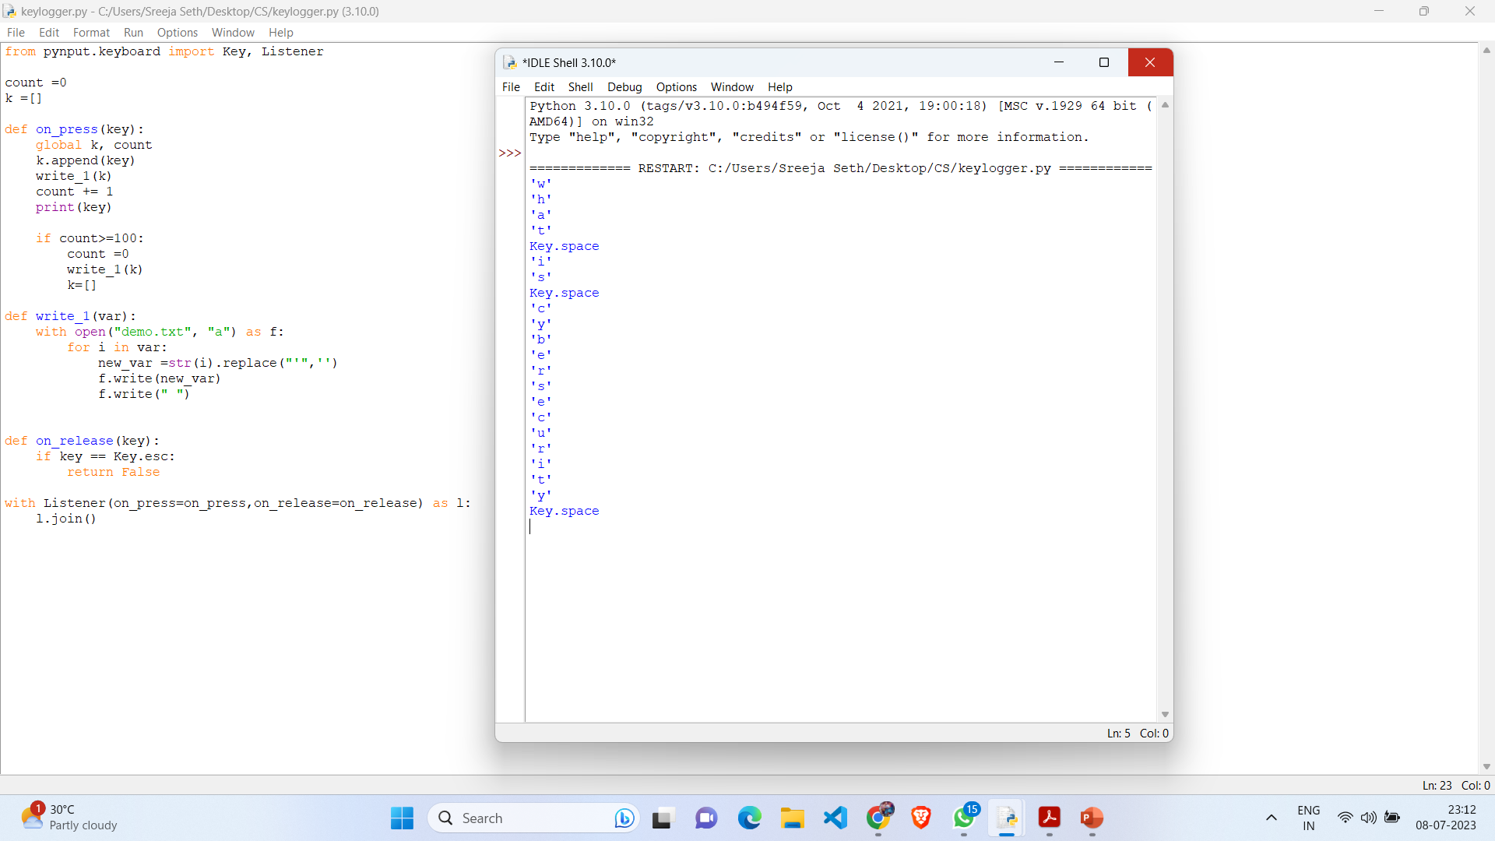
Results
The result of this project is creating a keylogger which detects the keystrokes of the keyboard. Here also I create this keylogger which shoes that what I typed from the keyboard that is automatically stored into a text file.
The screenshot of the output is :

Slide 12
Links
GitHub code Repository Link:-
https://github.com/sreeja-16/CYBERSECURITY
Google Drive Link:
https://drive.google.com/file/d/1cRHGEGduFLYMl97c-DL2sc1v6XDZ5wTa/view?usp=drive_link
References:
Security Engineering. A Guide to Building Dependable Distributed Systems - 2008 Edition · Ross J. Anderson.
Hacking: The Art of Exploitation (2nd Ed.) · 2. The Art of Invisibility:
Cybersecurity Essentials. Charles J. Brooks, Christopher Grow, Philip A. Craig Jr.

Slide 13
Conclusion
In conclusion, keyloggers are software or hardware tools designed to capture and record keystrokes entered on a computer or mobile device. While keyloggers have both legitimate and illegitimate applications, it is crucial to prioritize ethical considerations and respect privacy rights.
Legitimate uses of keyloggers include their deployment by organizations to monitor employee activity, by parents to safeguard their children's online experiences, and by security professionals and researchers for cybersecurity purposes. In these cases, it is important to ensure compliance with legal regulations and obtain appropriate consent from the individuals being monitored.
However, the unauthorized use of keyloggers or deploying them with malicious intent is unethical and illegal. Using keyloggers without the knowledge or consent of the user is a breach of privacy and can lead to serious consequences, such as identity theft, unauthorized access, and financial fraud.

Slide 14
THANK YOU..

